Slide 1
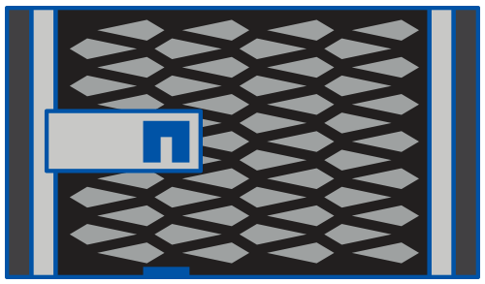


Architecture Overview
Cabling Overview
Cluster peering IP network, customer supplied
Cluster A
Data Center A
Cluster B
Data Center B
B1
HA pair Cluster interconnects Can be switchless Two, four, or six connections
A1
B1
HA
B2
HA
A2
B2
Two FC initiators and One 16-Gb virtual interface over FC (FC-VI) from each controller to each switch
Four FC switches and one to four ISLs per fabric
IP
Storage shelves Minimum recommended for production: four per site
FC
ISL
SAS
ATTO FibreBridges Two per stack
Notes:
ARCHITECTURE OVERVIEW: CABLING OVERVIEW
Instructor Notes
Student Notes
Cabling requirements and recommendations:
Recommended FAS8040 nodes: Four ISLs per fabric
Cluster interconnects: All FAS80x0, except 8020 nodes default to four cluster interconnects. See 80x0 guidelines on whether to choose two or four (or six, as supported in 8080).
Minimum production shelves: Two per site are supported. However, this two-shelf configuration allows only one small data aggregate. This configuration has poor performance.
Two or three disks are required for the root aggregate.
Two spare disks leave seven or eight disks, for only one possible data aggregate per node.
Finally, this configuration requires manual disk assignment, including subsequent replacements for failed disks. When only one node owns disks in each shelf, disk assignment is per-shelf.

