Slide 1
User inputs
Cascading inputs
Advanced query topics
Example – Wildcard filter

Slide 2

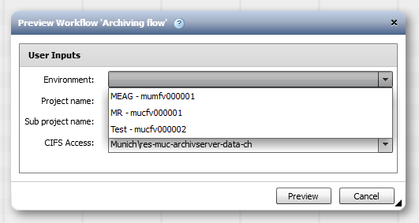
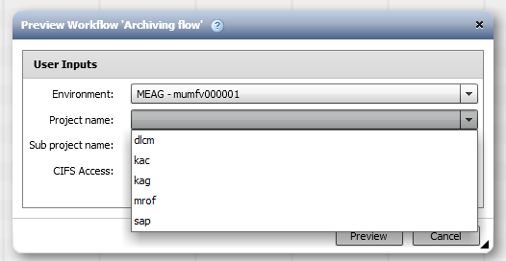
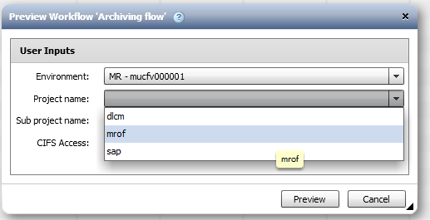

User input – Cascading inputs
A high traction feature in 1.1 release, where a field is impacted by the value of another

Slide 3
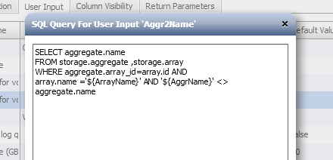
User input – Cascading inputs
Cascading can be done with various types of fields. Any kind of field can impact a query field.
A field value can change as a result of a selection –
When selecting 2 aggregates that have to be different,
Selection of the first would clear and refresh the values that are available for selection for the second.

Slide 4
User input – A wildcard field
User input queries may return a very long list of results, which make sifting through inconvenient.
Use-case:
  A project qtree quota resize flow
  Targeting a list of project volumes to select a specific
  project qtree from, in order to alter it’s quota
Points for consideration:
  Many qtrees in every project volume
  How can we know what’s the current quota (Providing that’s interesting)?

Slide 5
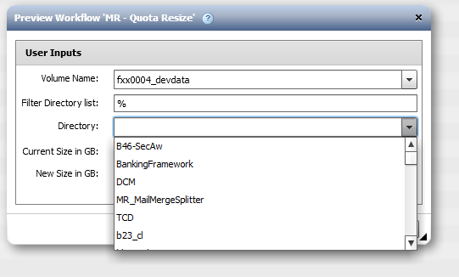
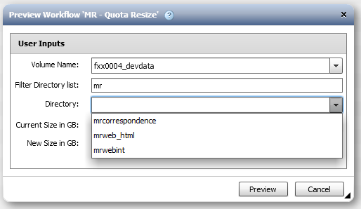
User input – A wildcard field
Reducing the project qtree result set:
  We created a string user-input field, defaulting with “%”, and allowed the user to narrow the result set by doing pattern matching to the qtree name

Slide 6
User input – A wildcard field
The query:
SELECT
qtree.name
FROM
storage.qtree qtree, storage.volume volume, storage.array array
WHERE
qtree.volume_id = volume.id AND
volume.name = '${VolumeName}' AND
array.name = '${ArrayName}' AND
array.id = volume.array_id AND
qtree.name <> '-' AND
qtree.name LIKE '%${pattern}%'

Slide 7
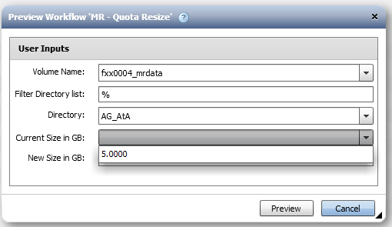
User input – A wildcard field
For good measure, we created an additional query to handle showing the current qtree quota:
SELECT qtree.disk_limit_mb/1024
FROM storage.qtree qtree, storage.volume volume, storage.array array
WHERE
array.name = '${ArrayName}' AND
array.id = volume.array_id AND
qtree.volume_id = volume.id AND
volume.name = '${VolumeName}' AND
qtree.name = '${QtreeName}‘

Slide 8
User input – Informative queries
WFA is using MySQL database. As such it supports some additional useful functions on top of the basic SQL functions.
For more, see here:
http://dev.mysql.com/doc/refman/5.0/en/functions.html
Functions allow us to create descriptive and informative drop downs that will combine multiple fields into one parameter. These can be used in conjunction with cascading inputs and or functions for breaking up the information inside the flow. It is all based on various delimiters that will be added to enable it.

Slide 9
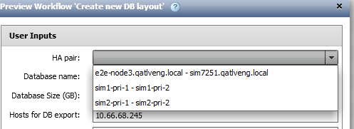
User input – Informative queries
Use case I – Select HA pairs
We were requested to work only with pairs and not with arrays. The query will
use the array table
and will construct a
pair listing by partner
arrays with “ – “ as a
delimiter.
SELECT DISTINCT IF(a1.name > a2.name,
CONCAT(a2.name," - ", a1.name), CONCAT(a1.name," - ",a2.name))
FROM STORAGE.array a1
JOIN STORAGE.array a2 ON a1.partner_id = a2.id

Slide 10
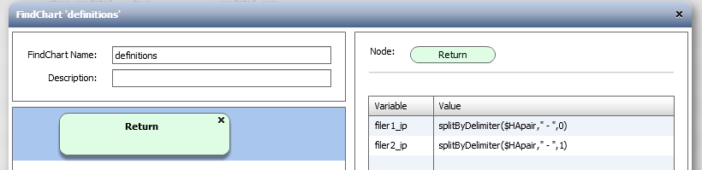
User input – Informative queries
Using “ – “ as delimiter will allow us to split the pair information later to the 2 controllers in a return node.
The blanks assure us that the delimiter is indeed singular.
Why do we check if filer1 name is larger than filer2 (lexicographically) ? Because we would like each pair to appear only once. The comparison and “Select distinct” allow that to happen

Slide 11
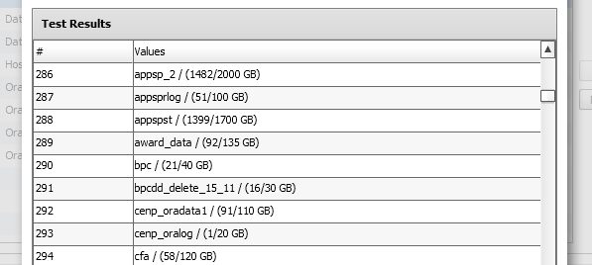
User input – Informative queries
Use case II – Add sizing info on volumes
Basic scenario will be adding the volume size to the name to give a hint on usage.
SELECT CONCAT (storage.volume.name, " / (", CEIL(storage.volume.used_size_mb/1024),"/",
CEIL(storage.volume.size_mb/1024)," GB)")
FROM storage.volume
Later, it would be
easy to split by
“ / “ and take the
first part to get
the volume name.

Slide 12
User input – Informative queries
Use case III – Add info to cascading queries
We want to select the environment, which would directly
imply which vfiler we will use.
select distinct CONCAT(aproj.name, " - ", aproj.vfiler)
from playground.archive_projects aproj
order by aproj.name asc
Later, we will use this to carve up just the project name from this combo:
select aproj.project
from playground.archive_projects aproj
where aproj.name = LEFT('${Env}', LOCATE(' - ', '${Env}'))

Slide 13
User input – Informative queries
Left returns the # of chars of a string ($Env) and would return the left part up to the “-”.
Will be MEAG, MR or Test

