Slide 1
OnCommand Insight Host File System Utilization
HVMFS

Slide 2
Capacity Utilization
Show the capacity utilization by the VM and Host
In the case of a thick provisioned lun, it helps to show how much capacity is utilized by the host/vm
In datawarehouse
Show the capacity utilization report
Tie this back to the storage and the tiers for showback
Trend the utilization to show when they might run out of capacity for that host
Notes:
Available for (Windows physical and virtual – Linux Virtual) capacity planning and Chargeback/Showback initiates
Enables end to end chargeback for Host to Storage
Agentless Discovery
Connected Block storage supported:
Clustered Data ONTAP, 7-Mode CLARiion
Windows VMware for FC, ISCSI, VMDK
Linux VMWare virtual disks (No ISCSI/FC at this time)
** Administrative VCenter credentials required if licensed for Host file system level Utilization

Slide 3
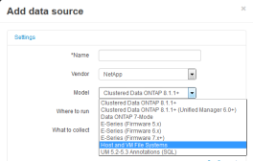
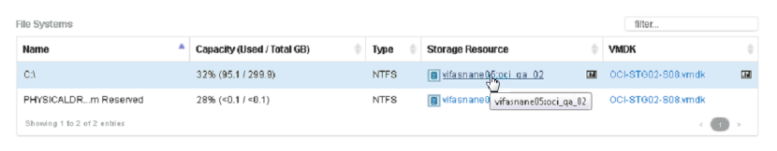
Host Utilization Pack
Agentless Host and VM File System Level Utilization available in Web UI and Data Warehouse
*Available in September
O/S type, CPU, Memory and FQDN
File system listing & type (C:\ D:\) (NTFS/FAT32)
File System Used Capacity (GB)
File System Total Capacity (GB)
Supports Windows Physical and Virtual
Logically map file system to back-end block storage (Clustered Data ONTAP, 7-Mode CLARiion)
NetApp Confidential - Internal Use Only
Notes:
In addition to Microsoft Windows, the NetApp Host and VM File Systems data source discovers file system details and storage resource mappings for all Red Hat Enterprise Linux Virtual Machine file systems that exist in the OCI server
Officially supported: Red Hat Enterprise Linux 7
Suspected to work but not yet verified:
Debian 6,7, Ubuntu, Fedora, CentOS
What does it do?
Collect OS instance metadata (hostname, cpu, mem, nic…)
Collect file system utilization
Map file system to block device
Report file system utilization with block device identification
VMWare virtual disk identifiers
Back End LUN serial numbers/other IDs
Initially only VMWare virtual disks are qualified, working on support for iSCSI, FC LUNs
A new mechanism was created to prevent problems from Hosts offline, reboots, latency and flickering. A black list is created where if OnCommand Insight detects a host is failing to discover, the host will be added to a Black List suspending polling until the following day. Hosts will persists in the OnCommand Insight database for up to 7 days.

Slide 4

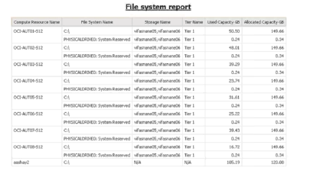




Support for Linux FSLU
Red Hat Enterprise Linux 7
Initially only VMWare virtual disks are qualified
NetApp Confidential - Internal Use Only

Slide 5
Host Utilization Pack
License
Host Utilization feature is enabled with a separate license.
“Host Utilization Pack”
Licensed by number of hosts
It has volume price based on the bands of number of hosts.
The number of hosts is aggregated across multiple purchases (like capacity)
Eg. Customer buys 200 host license initially. If they added 300 more hosts, those hosts will be priced in the band for 500 (initial 200 + new 300)
Availability in Quote tool
The new part number is expected to be available in quote tool end of September 2014.

Slide 6
Host Utilization Pack Licensing
“Host Utilization Pack”
Requires a separate purchasable license
Licensed based on number of hosts
No minimum for number of hosts purchased
Volume pricing on banded # of hosts. Enables Chargeback and Capacity Planning
Drag and drop host report authoring
File System relationship to Storage Resource and Tier
File System trending for:
Allocated Capacity
Used Capacity
Capacity Utilization
Host count 1 | to | 350
351 | to | 700
701 | to | 1100
1101 | to | 2000
2001 | to | 3000
3001 | to | 5000
5001 | to | 7000
7001 | to | 10000
10001 | to | 15000
15001 | to | 20000
20001 | to | 99998
99999 | to | 999999
NetApp Confidential - Internal Use Only
Notes:
Host Utilization Packs license available to be included in ELA’s

