Slide 1
Session BD-2-329 Building Private Clouds on E-Series The Swift Object Opportunity
Matt Tangvald

Slide 2
Agenda (60 min.)
NetApp OpenStack Overview 10 min.
E-Series + Swift 30 min.
Call to Action 5 min.
Q & A 15 min.

Slide 3
NetApp OpenStack Overview

Slide 4
3 Clusters → Private Cloud
App #1
E-Mail
NAS
DSS/ DW
SAN
App #3
DB with DAS
App #2
Storage
Swift object
Elastic Compute
Cinder Block
Data Analytics
Hadoop / NoSQL
Today
Tomorrow
Dedicated Vertical Silos Transform to Dynamic Clusters

Slide 5
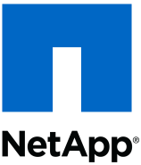
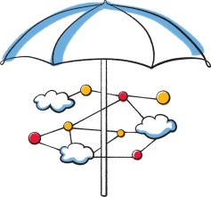
OpenStack: What Is It?
The decoder ring:
Service | OpenStack | Project Name | Amazon
Virtual Machines | Compute | Nova | EC2
Virtual Block Devices | Block Storage | Cinder | EBS
Object Storage | Object Storage | Swift | S3
Virtual Networks | Networking | Neutron (formerly Quantum) | VPC
App Orchestration | Orchestration | Heat | CloudFormation
App Monitoring | Measurement | Ceilometer | CloudWatch
Tenant Auth / Namespace | Identity | Keystone | IAM
Boot Images | Image Service | Glance | AMI
Dashboard | Dashboard | Horizon | Management Console
© 2013 NetApp, Inc. All rights reserved.
Notes:
Point is: Architecturally consistent w/ and API compatible w/ AWS

Slide 6
When to Sell...
In the Storage
Where is Data Management?
Outside the storage
Shared, General
What kind of workloads?
Application Driven
Entry/Mid-Range & Enterprise
Type of environment?
Entry/Mid-Range & Performance
Unified
Unified or Block?
Block
Scale Out Scale Up
Scale?
Scale Up
FAS
E-Series

Slide 7
OpenStack and NetApp Storage
Scalable Object
Private Cloud
VM Image
App Interface
Servers
Network
Storage
E-Series FAS
Application Driven
Storage Access
Shared Infrastructure
E-Series and FAS are Complimentary

Slide 8
E-Series + Swift

Slide 9
Object Storage Performance Continuum
Archival
Mixed Use
Transaction Processing
ILM
Large file
Random I/O
Multiple workloads
Large + small file
Home directory replacement
High performance
Capacity driven
Tape replacement
Small objects
Examples
Apple Siri
Scality
Example: StorageGRID
Examples:
OpenStack Swift
Ceph
Notes:
Need to clarify the Swift vs. StorageGRID – not just today, but the future SG.
Get with Duncan M. on aligning messaging.
Review Coringo / SG positioning.

Slide 10
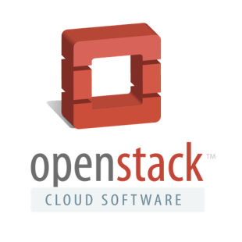
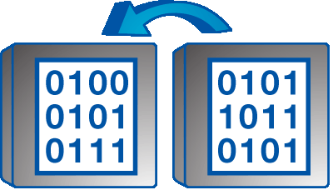
Swift (At Least 3 Copies of Data)
Swift
Storage Node
Consistent Hashing Ring
Storage Node
Any single object stored 3 Times
Storage Node
© 2013 NetApp, Inc. All rights reserved.
Notes:
Collapse this into one (de-emphasize Object)… keep it higher level. Prepare the crowd for the deep dive.

Slide 11
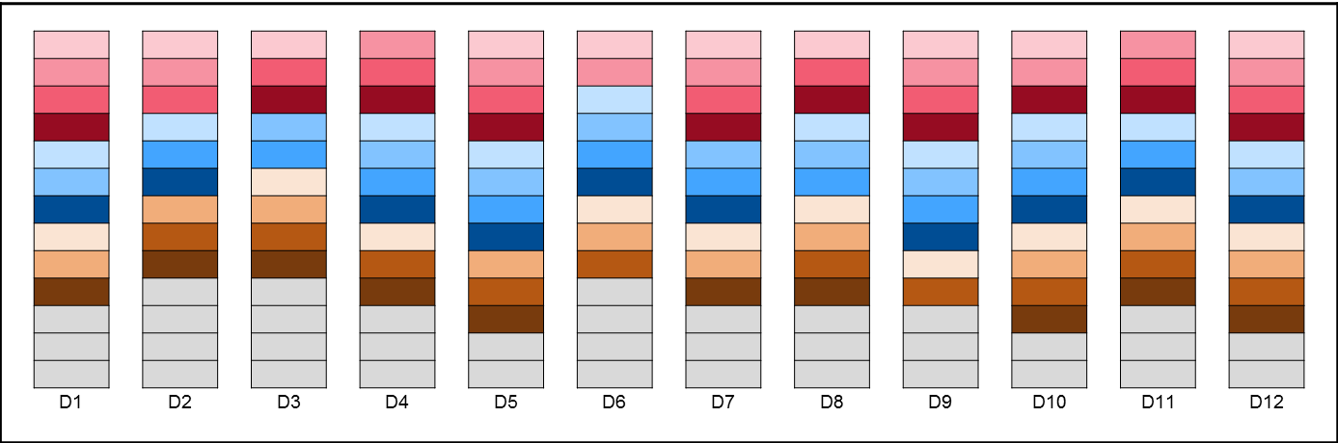
Swift (Efficient Storage & Scaling)
Swift
Any single object stored ~1.3X
E-series DDP
Dynamic distribution / re-distribution of data“De-clustered” RAIDEvolution of CRUSH
Space and scaling efficiency
© 2013 NetApp, Inc. All rights reserved.

Slide 12
Swift + Dynamic Disk Pools (DDP)
Swift advantages
Object level interface
Elasticity in scaling
Growth and expansion
Simple availability model
Ease of management
DDP advantages
Parity for disk protection
Built on RAID
Caching of data
Robust disk management
Dual path data access
Faster disk rebuilds
Performance at failure
Goal: Combine the Best of Both

Slide 13
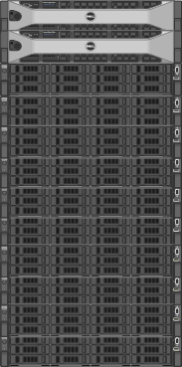
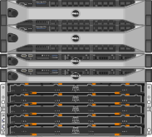
Why E-Series for Swift Object Storage
Denser
70% reduction in rack space used
10 2U servers → 2 2U servers + Exx60
DDP enables faster rebuilds
Large DAS Swift clusters are rarely optimal
DDP delivers performance under disk failure
HA ensures no single point of failure
>50% disk reduction
E-Series reduces TCO
$0.80 / GB SATA
$0.99 / GB SAS
$1.75 / GB List
$0.77 / GB @ 58%
DAS Swift
E-Series Swift
E-Series On Par CapEx with Reduced OpEx
Notes:
58% discount yields ~65% gross margin (based on Burdened COGS)
What is the equivalent DAS = E-Series price margin? = 45% discount, which yields ~73% gross margin
If you use Dell 2 TB 7200 RPM Server SATA Large Business FRU pricing = $279.99, $ / GB for DAS = $0.80
If you use Dell 2 TB 7200 RPM NL-SAS web site pricing = $410.33, $ / GB for DAS = $0.99
This is doable TODAY, with E-Series as is. Moving into the future, AI can enable the case where there would be no external servers at all. AI is critical to sustaining the E-Series differentiation for OpenStack Swift. Without AI, we are just another external block storage provider.
Today, not only do we reduce the rack size, server count, disk count and power consumption, we also reduce network traffic required to replicate 3 copies instead of just having 1 copy (at 1.3x with DDP) on E-Series. Further, the cluster state is maintained as optimal at a higher % of time, as single and double disk failures are handled by E-Series and are transparent the cluster.

Slide 14
OpenStack Performance
E-Series Performance Is Equivalent to Server DAS
Notes:
Common Components: 1 Dell 720 Compute node , 1 Dell 720 Controller node
Each Swift node provides proxy and object storage services
Reference cluster:
20U total height: 10 Dell 720 Swift servers each with 12 SAS devices.
E Series:
8U total height: 2 Dell 720 Swift servers with 6 LUNs per node.
6 LUNs in 4 drive pools. 4U60 drive enclosure.

Slide 15
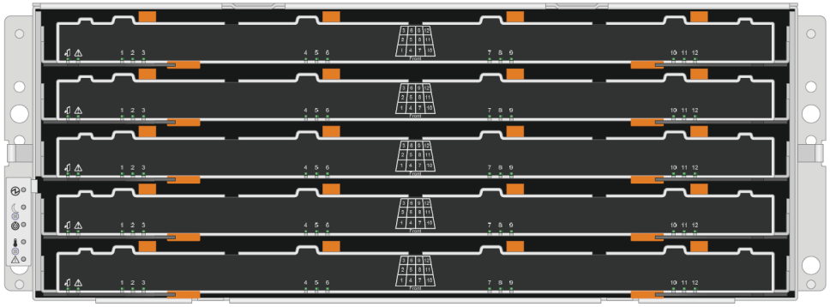
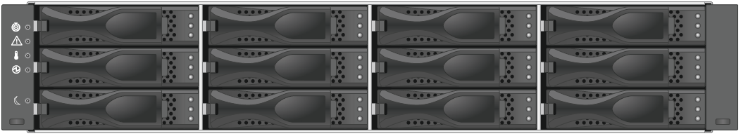
Scaling Swift with E-Series
Start Small
Scale Vertically with a Single Controller Pair
Scale Horizontally with Multiple Controller Pairs
E-Series + Swift Offers Virtually Unlimited Scaling

Slide 16
Why E-Series + Swift
The right tool
FAS replaces VM image management infrastructure
E-Series delivers higher efficiency than server replication
Lowers total disk count
Increases time cluster is in optimal state
Reduces network traffic required for replication / restore
The right time
Fortune 100 companies are
Not just experimenting with, but
Deploying OpenStack
Over 250 companies are contributing to OpenStack
Over 12,000 individual contributors
The Right Tool at the Right Time
Notes:
Customers who have expressed interest in OpenStack:
Intel
Comcast
AT&T Hosting
Sprint
Rackspace

Slide 17
NetApp OpenStack Integration Review
OpenStack Services
NetApp Hardware
Dashboard (Horizon)
Compute (Nova)
Networking (Quantum)
Block Storage (Cinder)
Image (Glance)
File Shares (Manila)
Object Storage (Swift)
Shared Services
e.g. Identity / Security (Keystone)
Data ONTAP
E-Series
StorageGRID
File Shares
Block Storage
Object Storage
Image

Slide 18

Getting Started with OpenStack at NetApp
News
http://netapp.com/openstack
@openstacknetapp
NetApp Resources
Gold Pitch Slides and FAQ on Field Portal
NetApp OpenStack Deployment and Operations Guide
OpenStack Community and Foundation
http://www.openstack.org
http://docs.openstack.org
Notes:
Recap what was in it for them. More formal summary…
Call for action?
Other sessions
Punchline: finality, completion
Make it personal: “you” language. “I’d like you to remember xxx”

Slide 19
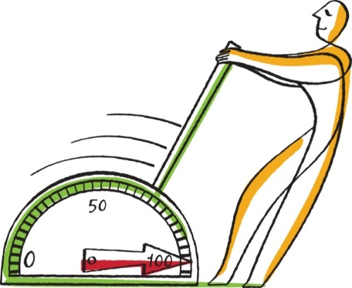
Resources
Success in Selling
E-Series
Field Portal
Expert Support
Partner Academies
Sizing Guides
Best Practice Guides
Hardware Universe
Tech Reports
Training
Simulators
E-Series Specialists
E-Series Field Portal
Resources
Partner Academies
E-Series Community
NetApp University:
Netapp.com
Sizing Guides
Simulators

Slide 20
Call to Action
When customers mention OpenStack, think NetApp
E-Series + Swift delivers lower TCO
Work to educate your partners on the E-Series + OpenStack opportunity
Continue to check the Field Portal to learn more
E-Series will be added to the NetApp OpenStack E-Series Deployment and Operations Guide

Slide 21
Q & A

Slide 22
Insight 2013 OpenStack and E-Series Sessions
DC-1-243 OpenStack Technology and Strategy Update
PL-2-711 E-Series Performance, Sizing and Tuning
PL-2-384 Features on E-Series: How E-Series Features Help your Customers
PL-2-390 E-Series Insight for FAS Experts
PL-2-709 EF540 Positioning, Performance and Best Practices
PL-2-712 EF540, SSD Cache, and E5X00 in Data Warehousing and Databases
BD-2-329 Delivering Robust, Scalable, Cloud Storage with E-Series
BD-3-505 High Performance Computing on NetApp E-Series
BD-1-618 How to Identify Big Bandwidth Workloads and Win with E-Series
BD-2-716 Winning with E-series in Video Surveillance and Cyber Security

Slide 23

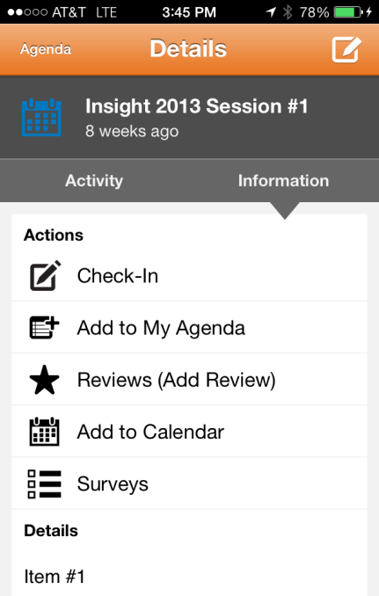
Take an Insight Survey!
NEW!
Click on the session number in your agenda.
Click on the Surveys Button.
Follow the prompts, complete the survey and submit!
Complete this survey by 7PM and be entered to win one of the following prizes:
1 iPad Mini 16GB Wifi
1 Bose SoundLink Mini Bluetooth
2 Jawbone Up Wristbands (Activity Tracker)
4 NetApp Signature Dry Zone Caps
Went to a different session? Need a translated survey? Visit the main survey page in the mobile app to take a daily survey – available in English, Chinese, Japanese and Korean.

Slide 24

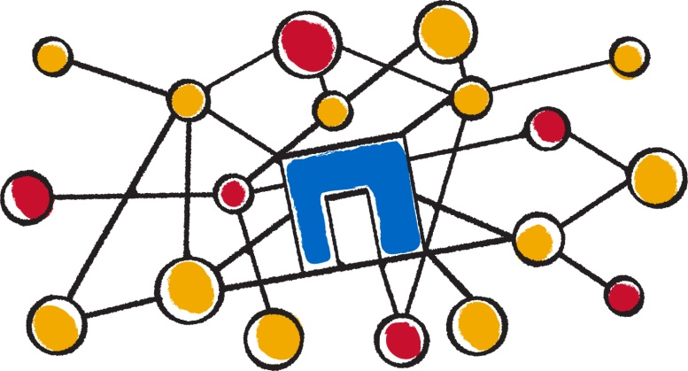
Facebook
www.facebook.com/NetAppInsightAmericas
www.facebook.com/NetAppInsightEMEA
Twitter
www.twitter.com/InsightAmericas
www.twitter.com/InsightEMEA
Tweet friends with #NTAPInsight

Slide 25

Matt
Tangvald

Slide 26
Session BD-2-329 Abstract
Building Private Clouds on E-Series
E-Series allows clouds to scale from a few TBs to PB-scale deployments independently of the compute infrastructure needs.
Deploying an object storage repository in either a corporate private cloud, or public cloud, requires an understanding of the end objective. You must decide on the storage and compute needs and develop a standard configured server that will be deployed end to end in the cloud. Changing server configs after deployment is difficult due to the requirement of a homogeneous environment. E-Series simplifies the deployment by allowing the separation between storage and compute. You can start a new storage pool with a minimum amount of compute HW, and you can dynamically scale your storage with no additional compute HW.
E-Series serves as an efficient OpenStack Swift object target (with a reduced replication count of one). E-Series can also be used as a Cinder block storage target. In fact, you can use the same E-Series controller for both Swift and Cinder. E-Series copy and mirroring features enable back end replication of volumes within the same environment, or between environments (Swift object &lt;--&gt; Cinder block).

Slide 27
Session BD-2-329 Takeaways
E-Series delivers a lower Total Cost of Ownership (TCO) for Private Clouds
E-Series can replaces DAS storage targets in OpenStack
E-Series enables independent scaling of compute and storage resources

Slide 28
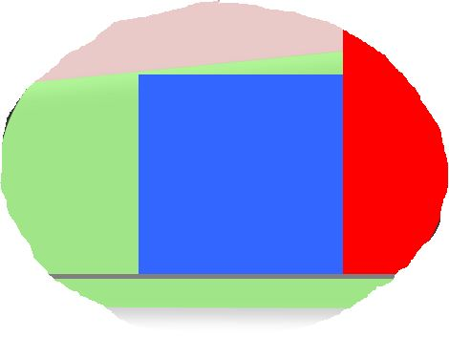
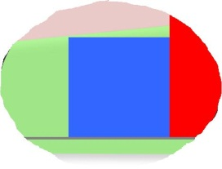
Data Rebalancing in Minutes vs. Days
Maintain Business
SLA’s with a drive failure
Performance Impact of a Disk Failure
Optimal
Acceptable
Business Impact
Performance
Business Impact
More than 4 Days
RAID
Time
DDP
2.5 Days
99% Exposure
Improvement
1.3 Days
96 Minutes
(Estimated)
Hours
Typical rebalancing improvements are based on a 24-disk mixed workload
Notes:
One of the biggest issues faced in storage management today is what happens if a disk fails.
As disk capacities get larger and larger, the time it takes traditional RAID systems to rebuild after a failure to an idle spare is getting longer and longer. This is because in traditional RAID the idle spare gets all the write traffic during a rebuild, slowing down the system and the data access while this is going on. In fact, as much as 40% performance degradation for up to 4 days! And as disk capacities increase, the rebuild time is going to go up. For instance, we’re looking at something on the order of 5.5 days to rebuild a disk. Can you imagine an entire week, Monday through Friday, just to rebuild one disk?
One of the main goals of DDP is to spread the workload around if a disk fails and its data must be rebuilt. This provides consistent performance and keeps you in the “green zone” to maintain a non-disruptive level of performance. DDP has shown the ability provide up to 1000 times faster reconstruction of a failed disk’s data throughout the pool when compared to a standard equivalent RAID configuration disk rebuild.
The dynamic process of redistributing the data occurs in the background in a non-disruptive, minimal-impact manner so I/O can continue to flow.
The magic of Dynamic Disk Pools is that effective, well performing systems can be made up any number of disks. No power of 2s or multiples of some number of disks are needed. Any number of disks will work (above the 11-disk minimum, that is). When a disk is added or lost, DDP rebalances data across the available disks. Using disk pools with larger number of physical disks reduces disk failure hot spots.
What Dynamic Disk Pools means to your customers is this:
1) Their business probably won’t even notice a disk loss
2) Their IT staff can deal with replacing failed disks when it’s convenient, which means no more “storage emergencies.”
NOTE: The 96-minute exposure was calculated using:
3TB disk * 80% (assumption of 80% full disk) = 2.4 TB = 2,400 GB.
Our experiments showed 2 minutes per rebalancing of 50G volume.
So 2,400GB / 50GB * 2 minutes = 96 minutes.

Slide 29


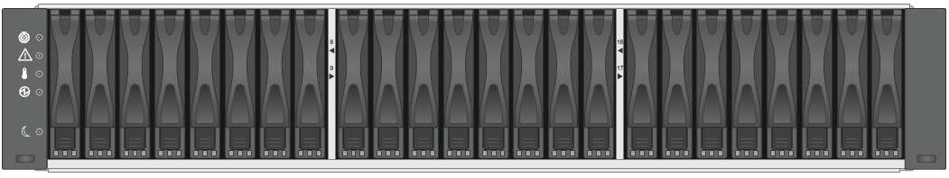
Modular Architecture – Any-to-Any
E2600
E5400
E5400
Controllers
DE6600 (4U/60)
(60) 3.5” drives
Highest throughput
Largest capacity/density
NL-SAS & SSD drives
DE5600 (2U/24)
(24) 2.5” drives
Highest throughput/RU
Great performance/watt
10K SAS & SSD drives
DE1600 (2U/12)
(12) 3.5” drives
Lowest entry price
NL-SAS drives
+
Disk Shelves
E5560 / E5460 / E2660
E5524 / E5424 / E2624
E5512 / E5412 / E2612
SYSTEMS
Visit the booth to see DE6600

Slide 30
NetApp Object Storage Options
Dedicated
Vertical
StorageGRID
Heterogeneous
Vertical
FAS
Heterogeneous
Flexible
Swift
E-Series
Dedicated
Flexible
General
E-Series
Solution Type
Workload Type

Slide 31
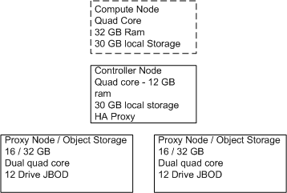
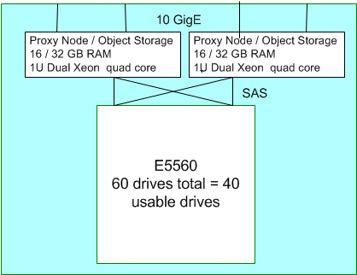
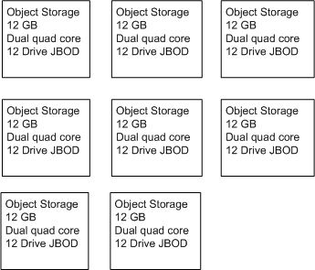
E-Series for Efficient Swift Object Storage
Before: 10 data nodes with DAS
12 drivers per node = 120 drives
3x replication → 40 drives usable
20U of servers
AFTER: 10 nodes replaced with 1 E-Series
60 drives in the E5460 Dynamic Disk Pool
No replication using DDP → 40 drives usable
2U of servers + E-Series → 6U
>50% Drive Reduction + 70% Less Rack Space
Notes:
Exact drive number is 54 drives, for a savings of 55%. However, drives are only orderable in 10 and 12 packs, so 54 rounds up to 60.

Slide 32
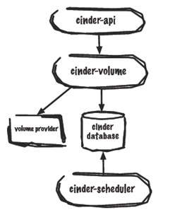
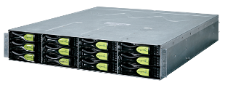
E-Series Cinder Block Provider
E-Series Cinder Solution
Cinder Provider / Driver
Standalone service SW module
Web Service: SYMbol / JSON based
Solution Availability
OpenStack / Grizzly API Coverage
Targeted completion mid-summer
Current WIP
Deciding general availability
Planning for support
E-Series
Cinder
Provider
Web
Service
Storage
Management
Service
SYMbol
KVM
Host
iSCSI

Slide 33
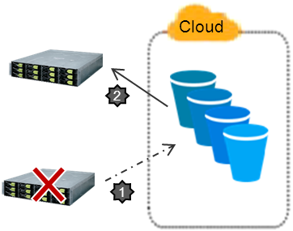
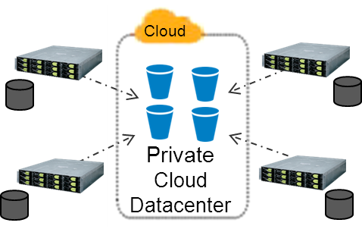
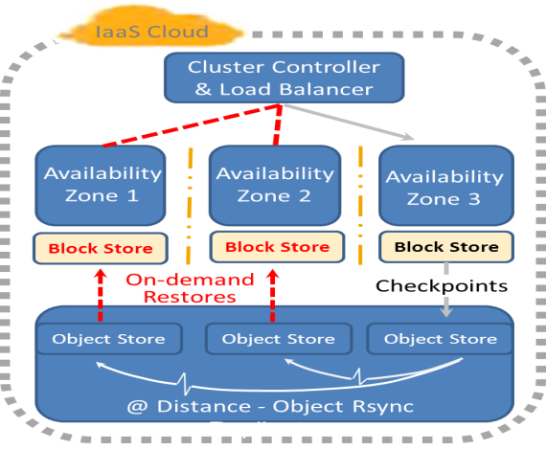
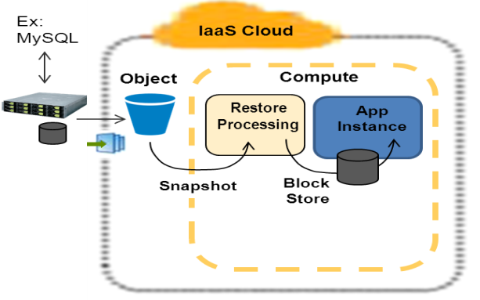
Future Investigations – Vaulting in the Cloud
#2
#1
Hub-n-spoke ROBO Backup
Bare-metal, On-premise DR
Centralized Backup
CDMI (StorageGRID)
High bandwidth
Public repository
REST s3, SWIFT, etc
Limited bandwidth
Public
Cloud
Prototyping with StorageGRID
Prototyping using AWS
#3
#4
Data Protection within-the-cloud
Recovery
in-the-cloud
Restore app / cloud CPU
Requires machine image
Goal to make simple
Open cloud capability
Target OpenStack
Cinder storage, snapshotting to SWIFT
Strong user interest
(Local-to-cloud integration)
Innovation Idea
(Service Providers)
Notes:
Benefits for SME’s from using Cloud Storage:
o Affordable “off-site” data protection
- Simply “getting data off-site” to a safe place, can be difficult for SMB’s
o Enable biz continuity for the SME (single site, especially)
- Affordable DR and allowing the business to continue with processing upon disaster
o “IaaS elastic” benefit
Data migration for hybrid cloud or cloud bursting usage
Object manifests: organize objects into something that can be “cloud compute mounted”
Cloud recovery Scripts: transfer and setup the IaaS compute environment for uploaded data image use
In addition, private cloud will also be supported with same REST interfaces

