Slide 1
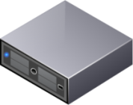
SMO Restore Problem
Success
Oracle Server
for Restore Server
Data
LUN 1.5TB
vol size = 3TB
Data
vol size = 3TB
Used 700GB
700GB
Temp
Flex Clone
36GB
Temp
36GB
TempDB is made within Data LUN. Capacity is available
240GB
LUN 240GB
Fail Situation
cannot make file
Data
LUN 1.5TB
Data
Used 1.5TB
1.5TB
Flex Clone
Temp
36GB
Temp
36GB
If Data LUN area is full, it can not re-make tempdb.
SMO is failed to mount operation.
240GB
LUN 240GB

